Slide 1


Data Analytics Project “Escape Buckingham Palace”
Trabalho realizado por:
Ana Matias
Augusto Eira
João Batista

Slide 2
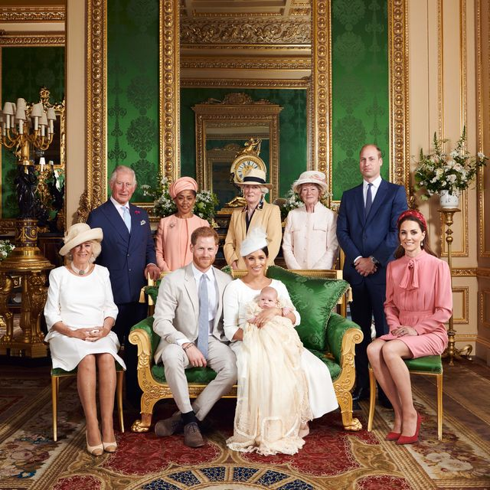
Could you imagine waking up in the Queen’s house? In this game that happens, but it’s not so good. You must leave the palace to avoid getting stuck with a crazy family.

Slide 3
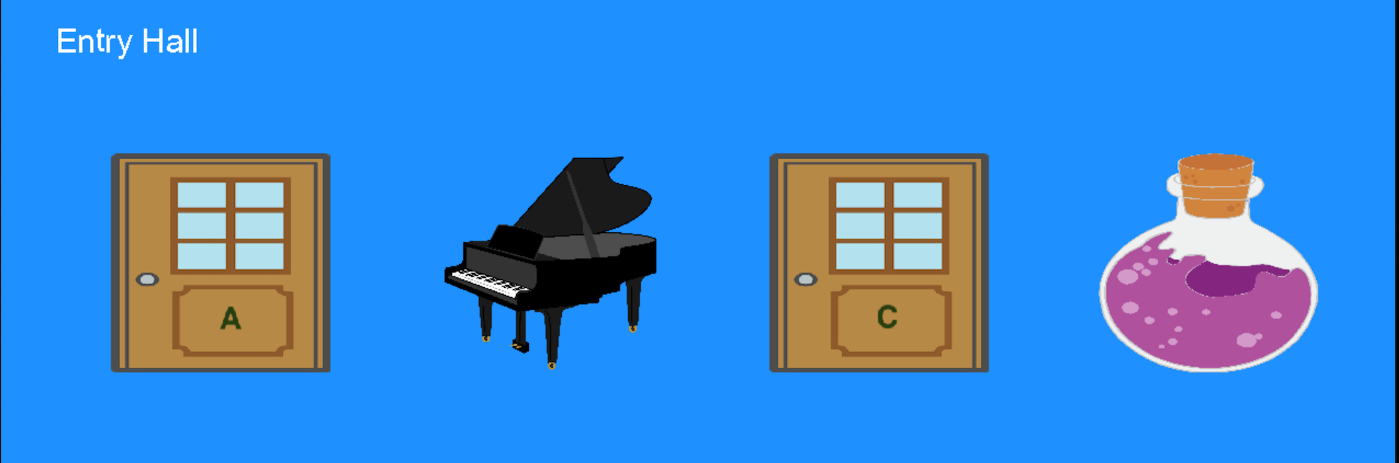
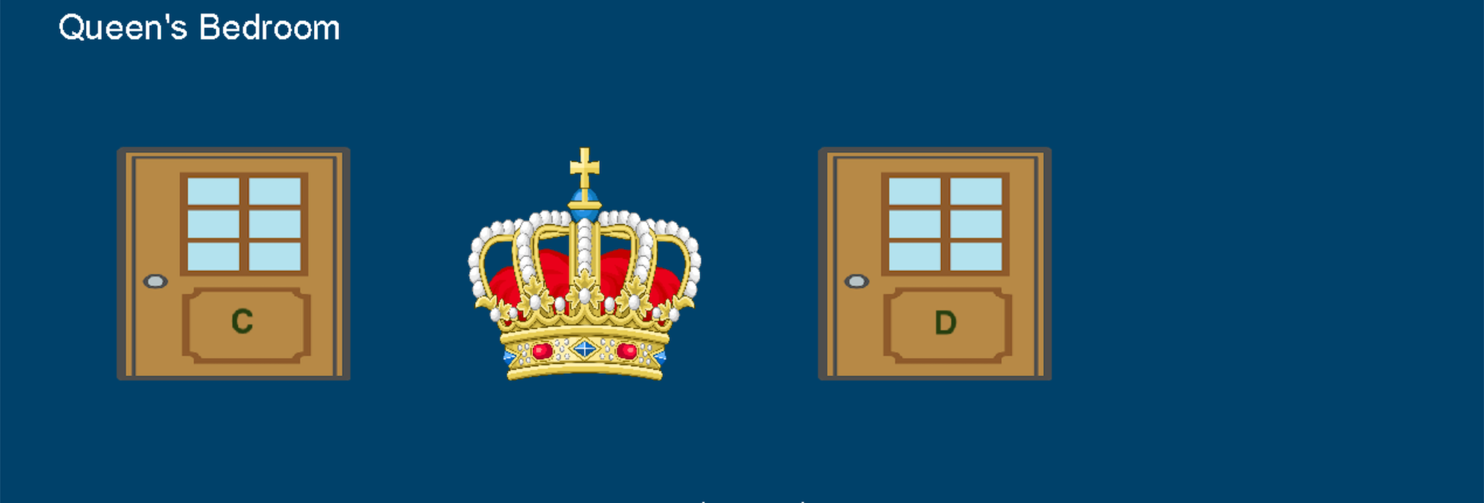

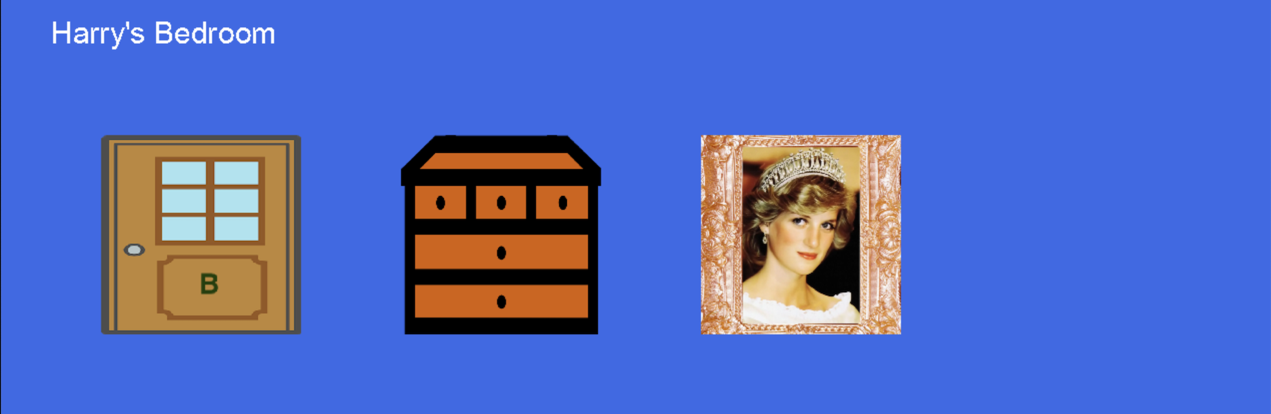
Game Rooms and Items

Slide 4





Energy, Time and Keys

Slide 5
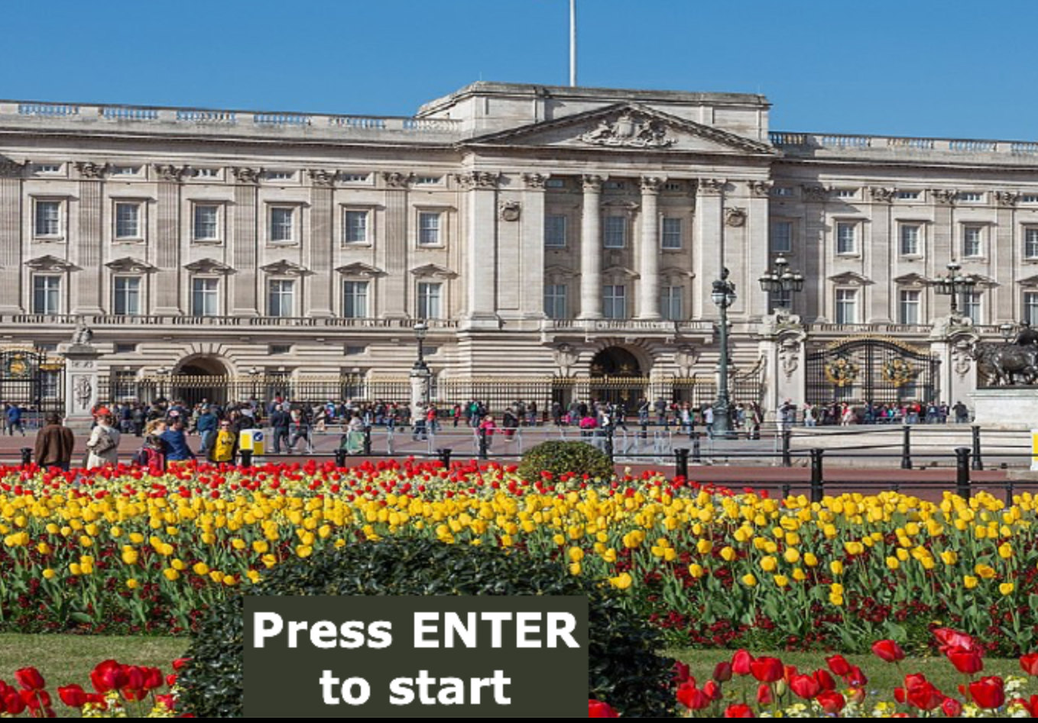
But let’s start the game!

Slide 6
ADD-ONS
Story
Sound
Images
Time
Interface

Slide 7
1.
Story
We changed the original items and their relations to create a new story.

Slide 8
2.
Sound
We imported pygame library to play sound.

Slide 9
3.
Images
We imported different images for each item and used pygame to display them in the interface

Slide 10
4.
Time
We imported time library to count the time until completion of the game

Slide 11
5.
Interface
We used pygame library to create an interface so that the player could have a more user friendly environment to interact with the game.

Slide 12


Next Steps
Include buttons. E.g: “Start” and “Exit”
Include a “try again” option to restart the game
Add diferent difficulty levels (higher level – starts with less time and energy)

Slide 13
Thanks!
Any questions?

